Slide 1
Pizza Sales Forecasting & Ingredient Planning
End-to-End Data Science Project Overview

Slide 2
Project Objective
Forecast weekly pizza sales using historical data.
Generate ingredient-level purchase orders for optimal inventory management.

Slide 3
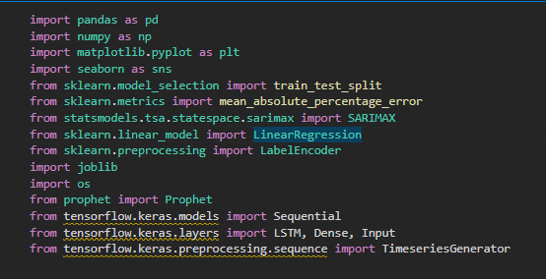
Libraries used

Slide 4
import pandas as pd # For loading, transforming, and analyzing structured data using DataFrames.
import numpy as np # For numerical computations, especially arrays and matrix operations.
import matplotlib.pyplot as plt # For plotting graphs and visualizing data.
import seaborn as sns # For enhanced statistical data visualization, built on matplotlib.
from sklearn.model_selection import train_test_split # To split datasets into training and test sets.
from sklearn.metrics import mean_absolute_percentage_error # To evaluate model accuracy using MAPE metric.
from statsmodels.tsa.statespace.sarimax import SARIMAX # For building SARIMA models for time series forecasting.
from sklearn.linear_model import LinearRegression # For applying simple and multiple linear regression.
from sklearn.preprocessing import LabelEncoder # To convert categorical values into numerical labels.
import joblib # For saving and loading machine learning models and scalers efficiently.
import os # For interacting with the operating system, like file paths and directories.
from prophet import Prophet # For time series forecasting with trends, seasonality, and holidays.
from tensorflow.keras.models import Sequential # For building neural networks sequentially layer by layer.
from tensorflow.keras.layers import LSTM, Dense, Input # For defining LSTM, Dense (fully connected), and input layers in neural networks.
from tensorflow.keras.preprocessing.sequence import TimeseriesGenerator # To generate input/output samples from time series for model training.

Slide 5
1. Data Cleaning
Removed missing or inconsistent entries in both sales data and ingredients data.
Handled outliers using statistical techniques which is IQR.
Formatted datetime columns and standardized inputs using

Slide 6
2. Exploratory Data Analysis (EDA)
Analyzed seasonality and weekly trends. Identified key features affecting sales.
Monthly sales trend : This bar chart displays the total sales for each month of 2015, showing some fluctuation throughout the year.
Pizza category sales trend : This bar chart indicates that "Classic" and "Supreme" are the highest-selling pizza categories.
Sales by Day of the Week : This bar chart illustrates that sales are generally highest on Fridays and Saturdays.
Hourly Sales Trend : This line graph shows total sales peaking around midday and again in the late afternoon/early evening , reflecting typical meal-time ordering behavior.

Slide 7
2. Exploratory Data Analysis (EDA)
Sales by Pizza Size: Large (L) pizzas had the highest sales, while XL and XXL sizes had minimal sales, likely due to low demand or high prices.
Sales by Pizza Category: Classic pizzas were the top-selling category, indicating customer preference for traditional flavors.
Price by Number of Ingredients: Total price generally increases with the number of ingredients, though there's variability due to premium toppings or special offers.
Correlation Heatmap: This heatmap visualizes the correlation between various numerical features, with darker red indicating a stronger positive correlation and darker blue indicating a stronger negative correlation.

Slide 8
3. Feature Engineering
Created features: day_of_week, is_weekend, is_veg, order_hour, month and number of ingredients for each pizza.
Encoded categorical variables (pizza_size, pizza_category, pizza_name_id) used LableEncoder.
Generated lag features and holiday flags.
Saved LabelEncoders for each column using joblib for future decoding.
Saved the feature-engineered dataset in two formats: Pickle file (feature_engineered.pkl) and Excel file

Slide 9
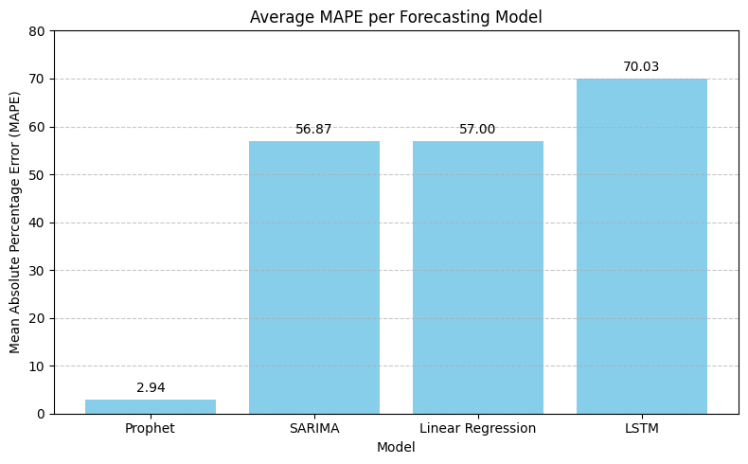
4. Model Evaluation
Used Mean Absolute Percentage Error (MAPE) to assess performance.
Compared models to select best performing one. And the prophet has the lowest MAPE which best score
Visualized actual vs predicted sales.

Slide 10
5. Model Selection
Considered multiple models: SARIMA, Prophet, LSTM, Linear Regression, which is suitable for series forecasting.
Selected Prophet model based on performance and interpretability. The MAPE of Prophet is 2.94 which is best among the all forecast model.
6. Model Training
Trained models on historical sales data.
Validated using a rolling forecast approach.
Utilized preprocessed features for improved accuracy.

Slide 11
7. Sales Forecasting
Renamed forecast columns ds to date and yhat to estimated_pizzas.
Clipped negative forecasts to zero and rounded estimated pizzas to 2 decimal places.
Sorted forecast data by pizza_name_id and date.
Merged pizza size and name info from the original sales data.
Rounded the entire forecast DataFrame for cleaner output.
Saved the 7-day detailed forecast to a CSV file (7_day_pizza_forecast.csv).
Aggregated total estimated pizzas per pizza over the 7-day period.
Rounded weekly estimated pizza counts to whole numbers.
Renamed the column to weekly_estimated_pizzas for clarity.
Merged pizza size and name again for enriched weekly forecast data.
Sorted the weekly forecast in descending order of estimated pizzas.
Exported the weekly forecast as a CSV file (7week_day_pizza_forecast.csv)

Slide 12
8. Ingredient Calculation & Purchase Order Creation
Loaded the cleaned ingredient data from an Excel file.
Renamed columns for consistency: pizza_ingredients to ingredient, and Items_Qty_In_Grams to quantity_per_pizza.
Merged the weekly pizza forecast with the ingredient data on pizza_name_id.
Calculated total grams needed for each ingredient using forecasted pizza quantities.
Grouped the data by ingredient to get total required quantity per ingredient.
Converted ingredient quantities from grams to kilograms.
Printed the final 7-day purchase order of ingredients.
Saved the purchase order to a CSV file named purchase_order_next_7_days.csv.

Slide 13
9. Streamlit dashboard
Displayed KPIs: total pizzas and total ingredients (kg).
Filtered top N pizzas by ID using a slider.
Plotted daily forecast (line chart) by pizza ID.
Plotted total and weekly pizza demand (bar charts).
Plotted total demand by pizza name (bar chart).
Displayed ingredient usage (pie chart).
Visualized ingredient requirement (bar chart).
Enabled Excel and CSV downloads for all reports.

Slide 14
Results
Accurate Sales Forecasting Achieved:
Best Model Identified:
Forecast Output Generated:
Ingredient Requirements Calculated:
Purchase Order Generated:
Streamlit Dashboard Built:
Business Insight Delivered:

